Slide 1

Heredity and Evolution
Human Evolution

Slide 2


Human Evolution
The same tools for tracing evolutionary relationships.
Excavating
Time-dating
Studying fossils
As well as determining DNA sequences – have been used for studying human evolution.
There is a great diversity of human forms and features across the planet.

Slide 3
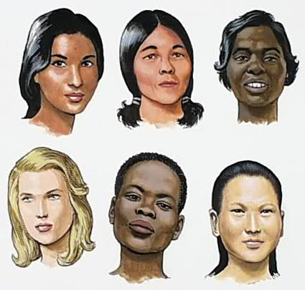
Human Evolution
There is a great diversity of human forms and features across the planet.
So much so that, for a long time, people used to talk about human ‘races’.

Slide 4

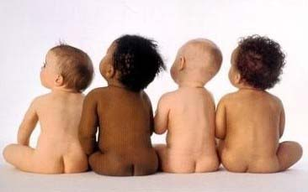
Human Evolution
Skin colour used to be the commonest way of identifying these so- called races.
Some were called yellow, some black, white or brown.
Have these different groups evolved differently?

Slide 5
Human Evolution
Have these different groups evolved differently?
Over recent years, the evidence has become very clear.
The answer is that there is no biological basis to the notion of human races.
All humans are a single species

Slide 6


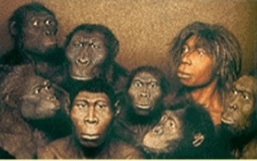
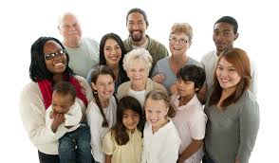
Human Evolution
Not only that, regardless of where we have lived for the past few thousand years, we all come from Africa.
While the residents spread across Africa, the migrants slowly spread across the planet – from Africa to West Asia, then to Central Asia, Eurasia, South Asia, East Asia.
The earliest members of the human species,
Homo sapiens , can be traced there.
Then they crossed the Bering land bridge to
the Americas.
Then they traveled to Australia from Philippines
Berlin land bridge
They travelled down the islands of Indonesia and Philippines
Asia
Africa
Philippines
Indonesia
America
Australia

Slide 7
Human Evolution
They went forwards and backwards, with groups sometimes separating from each other, sometimes coming back to mix with each other, even moving in and out of Africa.
Asia
Africa
Philippines
Indonesia
America
Australia

Slide 8

Human Evolution
Like all other species on the planet, they had come into being as an accident of
evolution, and were trying to live their lives the best they could.

Slide 9

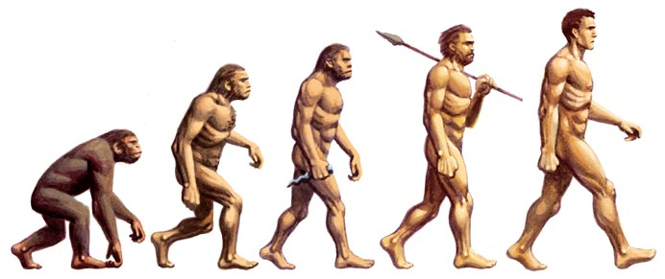

Slide 10
Thank You

